Slide 1
Child abuse – what you need to know
Lori Eastman, LCSW

Slide 2
Who am I?
I have been working with children and families for the last 20 years.
I have my Master’s in Social Work and went on to become a Licensed Clinical Social Worker.
I have primarily worked in healthcare, but have broad experience working with a variety of community agencies.
Notes:
I am by no means an “expert”, but I am hoping this gives you some insight into child abuse and what your role is if you suspect possible child abuse or child endangerment.

Slide 3
Disclaimer
As Family Promise Volunteers all we do we do in love and with respect and compassion.
Keep in mind cultural influences and avoid allowing personal beliefs or biases to influence decision making.
Notes:
Focus on understanding information provided by individuals within the context at hand ·
Remember to keep in mind cultural influences when assessing information or behavior ·
Resist the temptation to classify or label persons based on cultural preconceptions ·
Educate individuals/families from other cultures regarding American cultural expectations, practices, and traditions

Slide 4
What exactly is child abuse?
Child abuse or child maltreatment is physical, sexual, and/or psychological maltreatment or neglect of a child or children, especially by a parent or a caregiver. Child abuse may include any act or failure to act by a parent or a caregiver that results in actual or potential harm to a child, and can occur in a child's home, or in the organizations, schools or communities the child interacts with.
The State of California defines child abuse in Penal Code 273d PC as the willful infliction of either of the following on a minor under 18: (1) Any cruel or inhuman corporal (bodily) punishment, or (2) an injury that results in a “traumatic condition”.

Slide 5
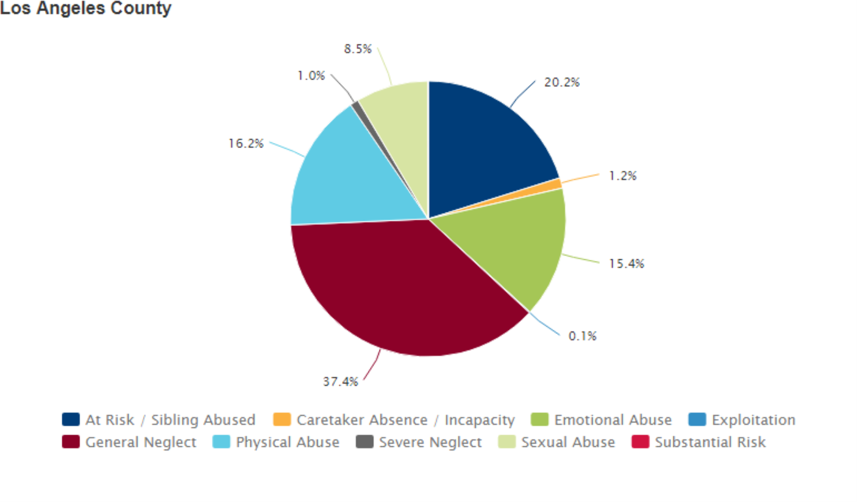
How prevalent is child abuse in LA County
Definition: Percentage of children ages 0-17 with reports of abuse or neglect, by type of maltreatment (e.g., among California children reported to have been abused or neglected in 2018, 19% were alleged to have been physically abused).
Data Source:As cited on kidsdata.org,Webster, D., et al. California Child Welfare Indicators Project Reports. UC Berkeley Center for Social Services Research (Jul. 2019).
In 2018 there were almost 2.3 million children in Los Angeles County
There were approximately 226,000 calls to the LA County Child Abuse hotline in 2018.

Slide 6
Myths and facts
Myth: It’s only abuse if it’s violent. Fact: Physical abuse is just one type of child abuse. Child neglect, sexual and emotional abuse can inflict just as much damage, and since they’re not always as obvious, others are less likely to intervene.
Myth: Only bad people abuse their children. Fact: Not all abusive parents or guardians intentionally harm their children. Many have been victims of abuse themselves and don’t know any other way to parent. Others may be struggling with mental health issues or substance abuse problems.
Myth: Abuse doesn’t happen in “good” families. Fact: Abuse and neglect doesn’t only happen in poor families or bad neighborhoods. These behaviors cross all racial, economic, and cultural lines. Sometimes, families who seem to have it all from the outside are hiding a different story behind closed doors.
Myth: Most child abusers are strangers. Fact: While abuse by strangers does happen, most abusers are family members or others close to the family.
Myth: Abused children always grow up to be abusers. Fact: It is true that abused children are more likely to repeat the cycle as adults, unconsciously repeating what they experienced as children. On the other hand, many adult survivors of child abuse have a strong motivation to protect their children against what they went through and become excellent parents.

Slide 7
Types of abuse
Physical abuse
Emotional abuse (or psychological abuse) is a pattern of behavior that impairs a child’s emotional development or sense of self-worth. This may include constant criticism, threats, or rejection as well as withholding love, support, or guidance
Neglect
Abandonment The inability or unwillingness of a parent or caregiver to provide ongoing care.
Exploitation means forcing or coercing a child into performing activities that are beyond the child's capabilities or which are illegal or degrading, including sexual exploitation. (human trafficking)
Sexual abuse
Parental Substance Use/Abuse Exposing a child to harm prenatally due to the mother’s use of legal or illegal drugs or other substances. Selling, distributing, or giving illegal drugs or alcohol to a child. Using a controlled substance that impairs the caregiver’s ability to adequately care for the child
Notes:
Physical discipline, such as spanking or paddling, is not considered abuse as long as it is reasonable and causes no bodily injury to the child. Injuries from physical abuse could range from minor bruises to severe fractures or death
Emotional abuse is often difficult to prove, and, therefore, child protective services may not be able to intervene without evidence of harm or mental injury to the child (Prevent Child Abuse America, 2016)

Slide 8
Considerations
Sometimes cultural values, the standards of care in the community, and poverty may contribute to what is perceived as maltreatment, indicating the family may need information or assistance.
It is important to note that living in poverty is not considered child abuse or neglect. However, a family’s failure to use available information and resources to care for their child may put the child’s health or safety at risk, and child welfare intervention could be required.

Slide 9
Signs of Physical abuse – nonaccidental physical injury to a child caused by a parent, caregiver, or other person responsible for a child
Has unexplained injuries, such as burns, bites, bruises, broken bones, or black eyes
Has fading bruises or other noticeable marks after an absence from school
Seems scared, anxious, depressed, withdrawn, or aggressive
Seems frightened of his or her parents and protests or cries when it is time to go home
Shrinks at the approach of adults
Shows changes in eating and sleeping habits
Reports injury by a parent or another adult caregiver Abuses animals or pets
Notes:
Consider the possibility of physical abuse when a parent or other adult caregiver exhibits the following (Prevent Child Abuse America, 2018):
Offers conflicting, unconvincing, or no explanation for the child’s injury or provides an explanation that is not consistent with the injury
Shows little concern for the child
Sees the child as entirely bad, burdensome, or worthless

Slide 10
Signs of neglect
Is frequently absent from school
Begs or steals food or money
Lacks needed medical care (including immunizations), dental care, or glasses
Is consistently dirty and has severe body odor
Lacks sufficient clothing for the weather
Abuses alcohol or other drugs
States that there is no one at home to provide care

Slide 11
Signs of sexual abuse - the victimization of a child by sexual activities, including molestation, indecent exposure, fondling, rape, and incest.
Has difficulty walking or sitting
Experiences bleeding, bruising, or swelling in their private parts
Suddenly refuses to go to school
Reports nightmares or bedwetting
Experiences a sudden change in appetite
Runs away
Reports sexual abuse by a parent or another adult caregiver
Attaches very quickly to strangers or new adults in their environment

Slide 12
How can I help?
Avoid denial and remain calm.
01
Don’t interrogate.
02
Reassure the child that they did nothing wrong.
03
Safety first.
04
Notes:
It’s normal to feel a little overwhelmed and confused.
Child abuse is a difficult subject that can be hard to accept and even harder to talk about—for both you and the child.
When talking with an abused child, the best way to encourage them is to show calm reassurance and unconditional support.
If you’re having trouble finding the words, let your actions speak for you.
A common reaction to news as unpleasant and shocking as child abuse is denial. However, if you display denial to a child, or show shock or disgust at what they are saying, the child may be afraid to continue and will shut down.
Let the child explain to you in their own words what happened, but don’t interrogate the child or ask leading questions. This may confuse and fluster the child and make it harder for them to continue their story.
It takes a lot for a child to come forward about abuse. Reassure them that you take what they said seriously, and that it is not their fault.
If you feel that your safety or the safety of the child would be threatened if you tried to intervene, leave it to the professionals. You may be able to provide more support later.

Slide 13
Reporting myths
I don’t want to interfere in someone else’s family. Child abuse and neglect is NOT merely a family matter, and the consequences of staying silent can be devastating for the child.
What if I break up someone’s home? A child abuse report does not mean a child is automatically removed from the home—unless they’re clearly in danger. Parents may be first offered support, such as parenting classes or anger management counseling.
They will know it was me who called. Reporting is anonymous, you do not have to give your name when you report child abuse.
What I have to say won’t make a difference. If you have a gut feeling that something is wrong, it’s better to be safe than sorry. Even if you can’t see the whole picture, others may have noticed signs as well, and a pattern can help identify child abuse that might have otherwise been overlooked.

Slide 14
Mandated reporting
All volunteers and staff of Family Promise are mandated reporters – Escalate any concerns to the site Coordinator who will escalate to the Executive Director.
Rights to Confidentiality and Immunity - Mandated reporters are required to give their names when making a report. However, the reporter’s identity is kept confidential. Reports of suspected child abuse are also confidential. Mandated reporters have immunity from state criminal or civil liability for reporting as required. This is true even if the mandated reporter acquired the knowledge, or suspicion of the abuse or neglect, outside his/her professional capacity or scope of employment.
Consequences of Failing to Report - A person who fails to make a required report is guilty of a misdemeanor punishable by up to six months in jail and/or up to a $1,000 fine (California Penal Code Section 11166[c]).
Use common sense – and never make a false or malicious report. If you are unsure, call the hotline and talk to an expert.

Slide 15
reporting
If you suspect a child is being abused or neglected or know of a family that may need additional support or access to resources, please contact Department of Children and Family Services (DCFS) immediately.
Reporting should be done when a person either knows or has a “reasonable suspicion” that a child has been or is in danger of abuse or neglect.
“Reasonable suspicion” means that most people, given the same facts and information, would suspect child abuse. Hard proof is not needed to make a report. However, reports must be in good faith.
Toll-free within California: (800) 540-4000

Slide 16
Reporting continued…

Slide 17
What to Expect When Contacting the Child Protection Hotline
You will be asked specific questions regarding the child(ren) you are reporting.
Name and age/DOB of the child(ren)
Family’s address and phone number
Name of mother and father and their whereabouts
Current location of child(ren)
Language spoken in the home
Describe the abuse and/or neglect in detail
When did the abuse occur and how often does it occur?
Location of the abuse and/or neglect
Does the child(ren) have injuries? If so, where and what kind of injuries?
Does the perpetrator have access to the child?
Is the child(ren) safe or is there immediate danger?

Slide 18
Upon completion of your verbal report, you will be given a 19 digit referral number. Write that number down. You will also be provided with the preliminary outcome of your call. Outcome possibilities include:
Immediate Response | (an in-person investigation will be conducted within 24 hours)
Five Days | (an in-person investigation will be conducted within five business days)
Evaluated Out | (an in-person investigation will not be conducted; however, your report may be cross-reported to law enforcement or another agency)
Information to Children's Social Worker | (an in-person investigation will not be conducted; however, information given by you will be forwarded to the assigned Children’s Social Worker)
Consultation | (the information given by you does not meet the definition of abuse or neglect; however, will be documented for future reference)

Slide 20
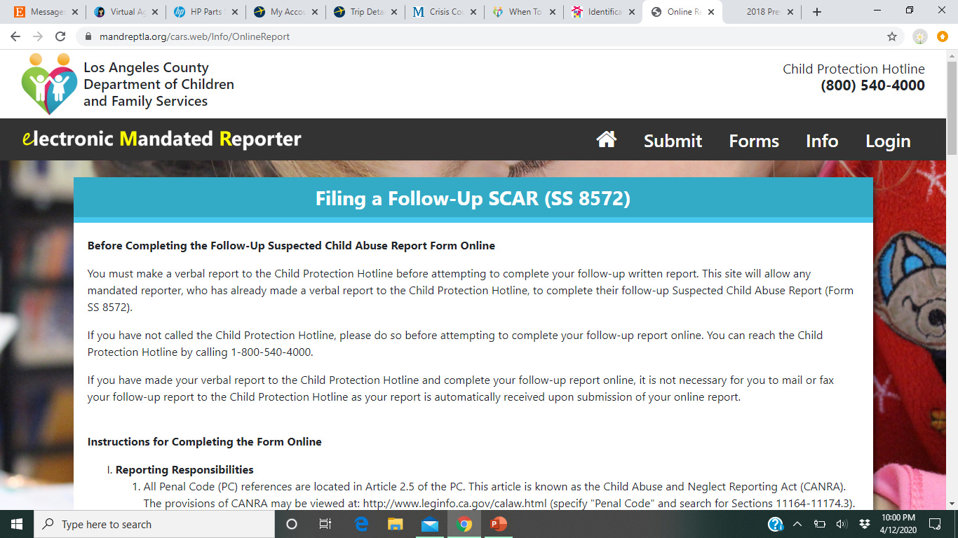
Next steps
Notes:
Show form

Slide 21
Questions?

